Slide 1
Standardization
Accreditation
“OIC/SMIIC Standards on Halal Issues and Halal Quality Infrastructure”
İhsan ÖVÜT
Secretary General, SMIIC
2020
Metrology
Notes:
Bismillahirrahmanirrahim,
Honorable guests, Brothers and Sisters,
Assalamu Alaikum wa Rahmatullahi wa Barakatuh,
I AM PLEASED TO ATTEND THIS ONLINE TRAINING SESSIONS AND TO HAVE THE OPPORTUNITY TO EXPLAIN WHAT IS THE ROLE OF SMIIC IN HALAL. I HOPE WE WILL HAVE FRUITFUL DELIBERATIONS AFTER PRODUCTIVE DISCUSSIONS.

Slide 2
OUTLINE
Organization of Islamic Cooperation (OIC)
Standards and Metrology Institute for Islamic Countries (SMIIC)
Standardization Activities in SMIIC
SMIIC Global Standards on Halal Issues and Islamic Rules in OIC/SMIIC Standards
Halal Quality Infrastructure
Conclusion
1
Notes:
HAVING SAID THAT, NOW I WILL SUMMARIZE MY PRSENTATION OUTLINE, I WILL START WITH A BRIEF INTRODUCTION OF OIC AND THEN I WILL GIVE SOME INFORMATION ABOUT SMIIC, ITS STRUCTURE, OBJECTIVES ETC. AND THE STANDARDIZATION ACTIVITIES…
AND I WILL EXPLAIN IN DETAIL SMIIC GLOBAL STANDARDS ON HALAL ISSUES AND ISLAMIC RULES IN OIC/SMIIC STANDARDS.
BY EXPLAINING HALAL QUALITY INFRASTRUCTURE, I WILL SHOW THE RELATION BETWEEN STAKEHOLDERS.
FINALLY I WILL CONCLUDE MY PRESENTATION BY BRIEFLY HIGHLIGHTING SMIIC’S FUNCTION IN HALAL QUALITY INFRASTRUCTURE.

Slide 3
ORGANIZATION OF ISLAMIC COOPERATION (OIC)
The second largest inter-governmental organization after the United Nations.
Established in September 1969.
57 Member States spread over four continents.
Collective voice of the Muslim world and ensuring to safeguard and protect the interests of the Muslim world.
2
Notes:
OIC IS AN INTER-GOVERNMENTAL ORGANIZATION LIKE THE UNITED NATIONS.
IT WAS ESTABLISHED IN 1969 AND HAS 57 ISLAMIC MEMBER STATES. ALSO HAS 5 OBSERVER STATES. HEADQUARTERED IN JEDDAH, KINGDOM OF SAUDI ARABIA.
AND IT IS THE SECOND LARGEST INTER-GOVERNMENTAL ORGANIZATION AFTER THE UNITED NATIONS AND IT DEFINES ITSELF AS THE COLLECTIVE VOICE OF WHOLE MUSLIM WORLD.
THE COUNTRIES DEMONSTRATED IN DARK GREEN ARE THE 57 MEMBER STATES OF THE OIC SPREADING OVER FOUR CONTINENTS.

Slide 4
Standards and Metrology Institute for Islamic Countries (SMIIC)
3
Notes:
SO WHAT IS SMIIC?

Slide 5
What is SMIIC ?
SMIIC is an intergovermental organisation and affiliated
to the OIC.
A Regional Standardization Body like CEN, SARSO, ARSO, GSO …etc.
Established in August 2010.
Headquarters located in Istanbul, Turkey.
Not a conformity assessment body (CB).
4
https://www.smiic.org/en
Notes:
SMIIC IS A TREATY BASED INTERGOVERNMENTAL ORGANISATION HEADQURTERED IN ISTANBUL, TURKEY, AND THE INSTITUTE IS AFFILIATED TO OIC.
IT WAS OFFICIALLY ESTABLISHED IN 2010 UPON THE COMPLETION OF RATIFICATION PROCESS OF ITS STATUTE BY ITS MEMBERS.
BRIEFLY, IT IS THE STANDARDIZATION BODY OF THE OIC. IT IS NOT A CONFORMITY ASSESMENT BODY, NOT A CERTIFICATION BODY. AND HAS AGREMENTS WITH AIDMO, GSO, ITC AND ARSO.

Slide 6
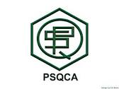
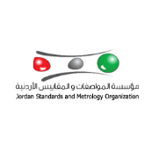
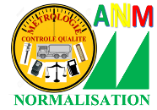
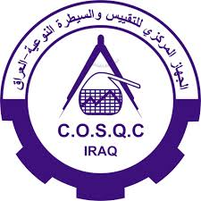
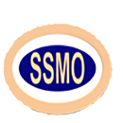
SMIIC MEMBERS
All OIC Member States through their National Standardization, Metrology and Accreditation Bodies can be a SMIIC member.
SMIIC has 42 Member States to date. (39 Full and 3 Observer Members as of January 2020) https://www.smiic.org/en/members
5
Notes:
SINCE ITS ESTABLISHMENT, THE NUMBER OF MEMBER STATES HAS GRADUALLY INCREASED AND REACHED TO 43 MEMBER STATES INCLUDING 4 OBSERVERS AS OF TODAY. I AM HONORED TO ANNOUNCE THAT, VERY RECENTLY, REPUBLIC OF INDONESIA, STATE OF KUWAIT AS MEMBERS AND RUSSIAN FEDERATION AS OBSERVER HAVE JOINED SMIIC FAMILY. AND WE ARE HAPPY TO WELCOME ESPECIALLY INDONESIA WHICH HAS VAST EXPERIENCE IN HALAL.
HERE YOU SEE LOGOS OF OUR MEMBERS. YOU CAN GET MORE INFORMATION ON ALL SMIIC MEMBERS VIA OUR WEBSITE.

Slide 7
VISION AND MISSION
VISION: To become a leading actor by making key contribution to the economic improvements and to the welfare of its Member States by means of establishing quality infrastructure and high quality standards.
MISSION: To develop harmonized standards and other relevant specific standards through a voluntary standardization process to expedite exchange of goods and services among Member States targeting uniformity in metrology and laboratory services, standardization, and accreditation activities supporting sustainable economic growth, within the frame of health and environmental protection, promotion of innovation and ensuring safety issues.
6
Notes:
THE VISION OF THE INSTITUTE IS MAKING KEY CONTRIBUTION TO OUR MEMBERS IN THE ESTABLISHMENT OF QUALITY INFRASTRUCTURE.
SO, WITH THAT VISION, OUR MISSION IS TO ESTABLISH STANDARDS THROUGH UNIFIED EFFORTS AND TO AID MEMBERS TO BUILD BETTER STANDARDIZATION, METROLOGY AND ACCREDITATION STRUCTURES.

Slide 8
MAIN OBJECTIVES OF SMIIC
To establish a conformity assessment scheme for the purpose of expediting exchange of materials, manufactured goods and products among Member States, beginning with mutual recognition.
To provide technical assistance to the Member States which do not possess such bodies.
To achieve uniformity in standardization, metrology and laboratory testing and in member states.
To prepare OIC/SMIIC standards
7
Notes:
ACCORDING TO ITS STATUTE, SMIIC HAS 8 OBJECTIVES. ON THE SLIDE WHAT WE HAVE IS THE SUMMARY OF THESE OBJECTIVES.
TO BEGIN WITH THE MOST IMPORTANT ONE, PREPARATION OF STANDARDS ESPECIALLY FOR THE OIC MEMBER STATES, IS THE MAIN TASK OF SMIIC.
THE INSTITUTE ALSO AIMS TO SERVE AS A COMMON PLATFORM FOR ALL MEMBER STATES’ RELEVANT BODIES IN STANDARDIZATION AND RELATED AREAS.
THE LAST BUT NOT THE LEAST, ESTABLISHING A CONFORMITY ASSESSMENT SCHEME FOR THE PURPOSE OF EXPEDITING EXCHANGE OF MATERIALS, MANUFACTURED GOODS AND PRODUCTS AMONG MEMBER STATES, MUSLIM COMMUNITIES, BEGINNING WITH MUTUAL RECOGNITION IS ONE OF MOST IMPORTANT OBJECTIVES OF SMIIC.

Slide 9
A BRIEF HISTORY – 1
1985 1999
2010
2011
2012
2013
The statute has entered into force and the Institute established in 2010 and the SMIIC General Secretariat initiated its activities in İstanbul in 2011.
SMIIC Member States increased to 20, New Technical Committees, Accreditation Committee and Metrology Committee established.
SMIIC Members increased to 29 and SMIIC Workshop for OIC-LDC Member States was held.
The draft Statute prepared and submitted to OIC Member States
8
Notes:
FIRST IDEA TO ESTABLISH SMIIC WAS RAISED AT COMCEC MEETING 1984.
STATUTE OF SMIIC ENTERED INTO FORCE AFTER FULFILLING THE RATIFICATION REQUIREMENT OF 10 OIC MEMBER STATES IN MAY, 2010. 1ST GENERAL ASSEMBLY MEETING OF SMIIC WAS HELD ON 02 AUGUST 2010 AND THE GENERAL SECRETARIAT STARTED ITS ACTIVITIES IN ISTANBUL IN 2011.
NEW TECHNICAL COMMITTEES, ACCREDITATION COMMITTEE, METROLOGY COMMITTEE WERE ESTABLISHED AND THE NUMBER OF SMIIC MEMBERS HAS CONTINOUSLY INCREASED.

Slide 10
A BRIEF HISTORY – 1
A BRIEF HISTORY – 2
2015
2016
2017
2018
2019
SMIIC Information System (IS) launched, SMIIC CCA and New TCs established. Strategic Plan 2016-2020 adopted.
New Standard OIC/SMIIC 5 on OSH adopted. The Institute restructured by 7 May 2017
SMIIC Members increased to 40 and AC, SMC and BOD’s members for 2018-2020 term was elected. TCs’ numbers has reached 15.
SMIIC Members increased to 42 and 13 OIC/SMIIC standards and new editions of SMIIC Directives published.
Number of SMIIC Members reached to 36 and new TCs established.
9
Notes:
IN 2015, THE SMIIC INFORMATION SYSTEM HAS BEEN LAUNCHED. THE SYSTEM IS PLANNED TO BE A FACILITATOR TO THE TECHNICAL WORK OF THE TECHNICAL COMMITTEES.
AND IN 2016, THE NUMBER OF MEMBERS HAS REACHED TO 36 MEMBER STATES WITH 3 OBSERVERS,. AND NEW TC PROPOSALS HAVE BEEN APPROVED BY MEMBERS.
RESTRUCTURING THE ORGANIZATION OF THE ORGANS OF THE INSTITUTE HAS BEEN AN IMPORTANT MILESTONE FOR THE INSTITUTE IN 2017. THE ORGANIZATIONAL CHART, FUNCTIONS AND RELATIONS OF THE UNITS…ETC. HAVE FUNDAMENTALLY CHANGED.
ON THE OTHER HAND A NEW STANDARD ON OCCUPATIONAL SAFETY AND HEALTH AS A RESULT OF COOPERATION WITH SESRIC AND LABOUR MINISTERS CONFERENCE OF OIC MEMBER STATES, HAS BEEN ADOPTED BY SMIIC.
IN 2018, NUMBER OF SMIIC MEMBER STATES HAS INCREASED TO 40 INCLUDING 3 OBSERVERS. NEW TERM FOR AC, SMC AND SMIIC BOD STARTED AND NUMBER OF TECHNICAL COMMITTEES REACHED TO 15.
MEANWHILE, IN 2019 SMIIC CONTINUED TO INCREASE ITS MEMBERS NUMBER BY REACHING 42 WITH 3 OBSERVERS AND HAS PUBLISHED 10 OIC/SMIIC STANDARDS IN TOTAL. NEW EDITIONS OF SMIIC DIRECTIVES AS THE GUIDE FOR TC WORK HAVE ALSO BEEN PUBLISHED.

Slide 11
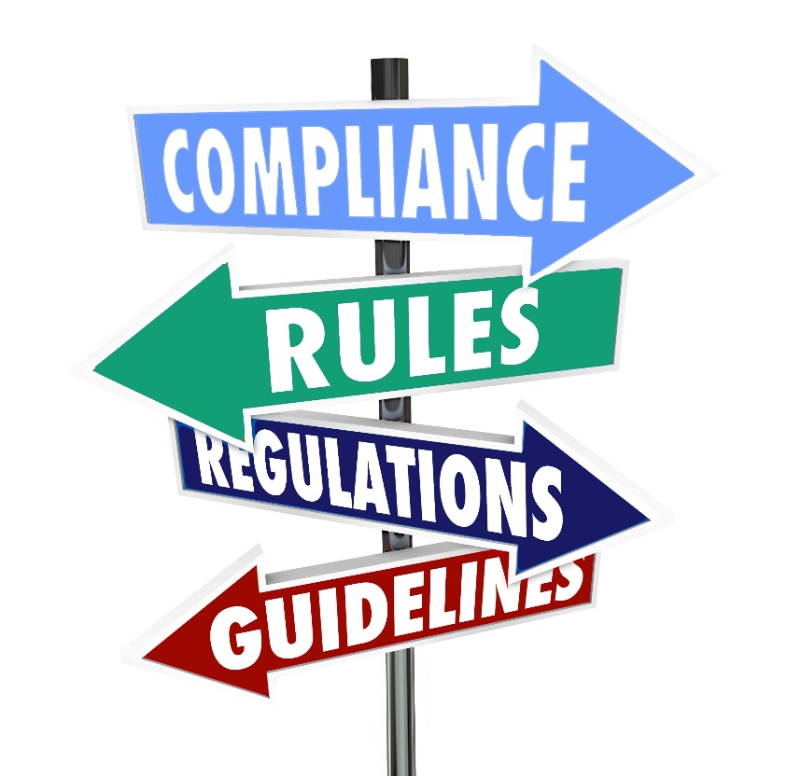
MAIN REGULATIONS OF SMIIC
SMIIC Statute
Rules of Procedure
SMIIC Strategy 2016-2020
Internal Regulations (Financial, Staff, etc.)
Directives and Guides
10
Notes:
SMIIC AS ONE OF THE YOUNGEST INSTITUTIONS OF THE OIC, HAS COMPLETED THE PREPARATION PHASE OF ALL THE REQUIRED DOCUMENTS TO ESTABLISH A ROBUST STRUCTURE WITHIN THE LAST FOUR YEARS. AND THESE DOCUMENTS ARE; SMIIC STATUTE WHICH IS THE ENACTMENT/CHARTER OF UTMOST IMPORTANCE IN IMPLEMENTING OBJECTIVES OF SMIIC AND THEN RULES OF PROCEDURE THAT CONTAINS REGULATIONS OF SMIIC IN CONDUCTING ITS ACTIVITIES AND IMPLEMENTING THE STATUTE. DIRECTIVES AND GUIDES FOR THE PREPARATION AND USE OF OIC/SMIIC STANDARDS AND OTHER DOCUMENTS FOR INTERNAL USE: STAFF REGULATIONS, FINANCIAL REGULATIONS AND FINALLY, SMIIC STRATEGY 2016-2020 WHICH IS A DOCUMENT AND THE PROCESS OF DEFINING SMIIC’S STRATEGY, OR DIRECTION, AND MAKING DECISIONS ON ALLOCATING RESOURCES OF THE INSTITUTE TO PURSUE THIS STRATEGY. FURTHERMORE, SUPPLEMENTARY DOCUMENTS TO SMIIC STRATEGY INCLUDING THE KEY PERFORMANCE INDICATORS (KPIS), INITIATIVES AND PROJECTS AND GOVERNANCE METHODS HAVE ALSO BEEN APPROVED FOR THE PROPER IMPLEMENTATION OF THE SMIIC STRATEGY 2016-2020.

Slide 12
SMIIC Strategic Plan 2016-2020
Develop high-quality standards
Enhance society confidence and quality infrastructure
Improve connectivity and integration between members
Develop networking for success
Develop and improve utilization of resources and capabilities
11
Notes:
SMIIC Strategic Plan 2016-2020 includes 5 main strategic approaches and total 33 strategies under these approaches:
-DEVELOPPING HIGH-QUALITY STANDARDS,
-QUALITY INFRASTRUCTURE,
-IMPROVING CONNECTIVITY OF MEMBERS
-NETWORKING AND
-UTILIZATION OF RESOURCES.
These approaches are implementing via action plans and annual projects.
NOW, WE HAVE STARTED OUR INITIAL WORK TO PREPARE THE NEW STRATEGIC PLAN OF SMIIC FOR 2021-2030 AND IT IS EXPECTED TO BE APPROVED IN NOVEMBER 2020.

Slide 13
ORGANIZATIONAL CHART OF SMIIC
Accreditation Council
(SMIIC AC)
(12 Elected Bodies, AC MAC)
General Assembly
(All Member States)
Board of Directors
(13 Elected Member States)
General
Secretariat
Standardization Management Council
(SMIIC SMC)
(9 Elected Bodies)
Metrology Council
(SMIIC MC)
(All SMIIC Members’ National Bodies)
Standing Advisory Committee
Reports/Responsible
Advising
12
Notes:
THE GENERAL ASSEMBLY IS THE SUPREME DECISION-MAKING ORGAN OF THE SMIIC AND COMPOSED OF THE MEMBER STATES. THE GENERAL ASSEMBLY HAS ALL THE POWERS NECESSARY TO ACHIEVE THE PURPOSE OF THE INSTITUTE.
THE BOARD OF DIRECTORS IS THE ORGAN ENTRUSTED WITH THE SUPERVISION OF THE EXECUTION OF THE PROGRAMS, PLANS AND ACTIVITIES OF THE INSTITUTE. THE BOARD OF DIRECTORS COMPRISES OF THIRTEEN MEMBERS ELECTED BY THE GENERAL ASSEMBLY FOR A TERM OF THREE YEARS.
UNDER THE BOARD OF DIRECTORS WE HAVE THREE COUNCILS
1-STANDARDIZATION MANAGEMENT COUNCIL
2-METROLOGY COUNCIL
3-ACCREDITATION COUNCIL

Slide 14
WHAT IS A STANDARD?
STANDARDIZATION ACTIVITIES IN SMIIC
A DOCUMENT established by CONSENSUS,
Approved by a RECOGNIZED BODY,
Contributed by its STAKEHOLDERS,
For COMMON and REPEATED USE,
VOLUNTARY.
A DOCUMENT WHICH DEFINES THE MUSTS OF A
PRODUCT OR SERVICE OR PROCESS
13
Notes:
SO, LETS TAKE A BRIEF GLANCE ON THE STANDARDIZATION ACTIVITES OF SMIIC TO BETTER COMPREHEND HOW SMIIC FUNCTIONS AS A TECHNICAL BODY AND HOW ITS ORGANS OPERATE IN THEIR FIELDS.
FIRSTLY, I WOULD LIKE TO GIVE A SHORT INFORMATION ABOUT STANDARDS AND STANDARD’S MAKING PROCESS IN GENERAL.
STANDARD IS A DOCUMENT THAT DEFINES THE MUSTS OF A PRODUCT OR SERVICE OR A PROCESS.
VOLUNTARY, AGREED ON BY CONSENSUS, APPROVED BY A RECOGNIZED BODY, FOR COMMON AND REPEATED USE BY EVERYBODY ARE THE MAIN NECESSITY FOR A STANDARD.
ESPECIALLY IN HALAL INDUSTRY, THE TERM “STANDARD” IS USING WRONGLY. EACH CERTIFICATION BODY SAYS THEY HAVE A STANDARD. THIS IS NOT A STANDARD. THIS IS THEIR OWN DOCUMENT.

Slide 15
CONSENSUS IN STANDARDIZATION
SMEs
Industry
GOs
Consumer
Chamber of Commerce
STANDARDIZATION
R&D organizations
Private Sector
NGOs
CONSENSUS ON STANDARDIZATION IS BEST ACHIEVED BY THE CONTRIBUTION OF ALL STAKEHOLDERS
14
Notes:
IF YOU WANT TO CALL A DOCUMENT AS A GOOD STANDARD, THE DOCUMENT SHOULD BE A PRODUCT OF CONSENSUS BASED STANDARDIZATION PROCESS WHERE THE CONTRIBUTION OF ALL STAKEHOLDERS HAS BEEN TAKEN INTO ACCOUNT.
STAKEHOLDERS SUCH AS INDUSTRY, CONSUMERS, GOs, NGOs, PRODUCERS, CERTIFIERS, PRIVATE SECTOR, RESERCHERS, LABORATORIES, UNIVERSITIES, ETC. ….
THIS IS WHAT WE CALL A «STANDARD» AND SMIIC STANDARDS ARE DEVELOPED WITHIN THIS PERSPECTIVE.

Slide 16
STANDARDIZATION MANAGEMENT COUNCIL (SMC)
SMIIC organ assigned the task of development of OIC/SMIIC standards in cooperation with Member States.
SMC coordinates and oversees the performance of the Technical Committees.
15
Notes:
AFTER GENERAL INFORMATION ON STANDARDS MAKING PROCESS, WE CAN NOW TALK ABOUT SMIIC STANDARDIZATION ORGANS AND ACTIVITIES.
STANDARDIZATION MANAGEMENT COUNCIL (SMC)
IS THE ORGAN OF SMIIC WHICH MANAGES ALL TECHNICAL COMMITTEES.
SMC OBSERVES THE PERFORMANCE OF THE TECHNICAL COMMITTEES AND CAN DECIDE TO ESTABLISH OR DISSOLVE A TECHNICAL COMMITTEE.
Standardization Management Council consists of a vice-chairman of the SMIIC Board of Directors as chair and 9 Member States elected by the Board of Directors.

Slide 17
METROLOGY COUNCIL (MC)
MC members are national metrology institutes of the Member States and Observers of SMIIC.
MC shall make cooperation in all types of metrology activities and policies among SMIIC Member States.
16
Notes:
OUR METROLOGY ACTIVITIES ARE CARRIED OUT BY SMIIC METROLOGY COUNCIL THAT IS COMPOSED OF SMIIC MEMBER STATES’ NATIONAL METROLOGY INSTITUTIONS.
MAIN TASK OF THE COUNCIL IS TO ENHANCE COOPERATION BETWEEN THE DEVELOPED AND DEVELOPING MEMBERS STATES’ METROLOGY CAPACITY.

Slide 18
ACCREDITATION COUNCIL (AC)
AC is responsible for supporting actions for establishing a sound accreditation system OIC-wide and raise awareness of accreditation concept within the Member States.
Membership is limited to the national accreditation bodies of SMIIC Member States.
12 (twelve) national accreditation bodies for the management of AC.
AC is the organ carrying out activities aimed at the establishment of an accreditation scheme in the OIC Member States.
17
Notes:
SMIIC ACCREDITATION COUNCIL IS THE NEW ORGAN UNDER SMIIC CARRYING OUT THE ESTABLISHEMENT OF AN ACCREDITATION SCHEME IN THE OIC MEMBER STATES.
BRIEFLY SAYING, THE COUNCIL IS RESPONSIBLE FOR ESTABLISHING AN OIC-WIDE ACCREDITATION SYSTEM.
ONLY NATIONAL ACCREDITATION BODIES OF SMIIC MEMBER STATES CAN BECOME MEMBERS OF THE COUNCIL
12 MEMBERS ARE BE IN THE MANAGEMENT OF THE COUNCIL.

Slide 19
TECHNICAL COMMITTEES - 1
Standards are not developed by the standardization organization itself.
Standardization is handled by various Technical Committees composed of member states.
O-members
P-members
Liaisons
18
Notes:
WHO PREPARES THE STANDARDS? SMIIC IS NOT DEVELOPING STANDARDS ITSELF YET ITS TECHNICAL COMMITTEES DEVELOP STANDARDS.
EACH TECHNICAL COMMITTEE WORKS AS AN INTERNATIONAL BODY. HERE ALL ACTIVITIES ABOUT PREPARATION OF STANDARDS ARE CARRIED BY THE MEMBER STATES, NOT BY CENTRAL AUTHORITY.
MEMBER STATES HAVE RIGHT TO VOTE IN ALL LEVELS OF STUDY.

Slide 20
TECHNICAL COMMITTEES - 2
Technical decision making body with
a precise title,
a scope,
and a work programme.
Acts in accordance with an agreed business plan
THE DEVELOPMENT AND SYSTEMATIC MAINTENANCE OF THE OIC/SMIIC STANDARDS WITHIN A PARTICULAR SCOPE OF WORK
19
Notes:
SO WHAT IS A TECHNICAL COMMITTEE ?
TECHNICAL COMMITTEES CONDUCT THEIR ACTIVITIES WITH SPECIFIC TITLE, SCOPE, WORK PROGRAM AND STRATEGIC BUSINESS PLAN AND TCS ARE THE KEY BODIES THAT DRIVE THE STANDARDIZATION PROCESS.

Slide 21
TECHNICAL COMMITTEES - 3
A secretary and a chairman
P and O Members and liaison organizations
Experts
Invited observers
20
Notes:
EACH COMMITTEE IS GOVERNED BY A SECRETARY AND A CHAIRMAN AND THE SECRETARIAT ACTIVITIES ARE CONDUCTED BY A MEMBER STATE.
NATIONAL STANDARDIZATION BODIES ARE REPRESENTED AS PARTICIPATING OR OBSERVING MEMBERS IN TECHNICAL COMMITTEES.

Slide 22
Main Documents for the Standardization Activities
SMIIC Directives:
Part 1: Procedures for the Technical Work
Part 2: Rules for the Structure and Drafting of OIC/SMIIC Documents
SMIIC Guides:
Guide 1: Guide on Adoption of OIC/SMIIC Standards
Guide 2: Guiding Rules for the Distribution and Sales of
OIC/SMIIC Standards
21
Notes:
ALL STANDARDIZATION ACTIVITIES ARE CONDUCTED IN COMPLIANCE WITH THE MAIN DOCUMENTS, NAMELY, SMIIC DIRECTIVES ISSUED BY SMIIC.
ALL TECHNICAL COMMITTEES SHOULD OBSERVE THE RULES STATED IN THESE DOCUMENTS.
HERE YOU CAN SEE THE CURRENT MAIN DOCUMENTS.

Slide 23
PROJECT APPROACH
OIC/SMIIC Standards are developed on the basis of a project approach by TCs
A project is any work intended to lead to the issue of a new, amended or revised OIC/SMIIC Standard
22
Notes:
EVERY STANDARD TO BE ISSUED OR REVISED IS CONSIDERED AS A PROJECT UNDER A TECHNICAL COMMITTEE.
ALL STANDARD PROJECTS ARE DEVELOPPED WITHIN TECHNICAL COMMITTEES AND FINALIZED AFTER HAVING CONSENSUS.

Slide 24
Development process for an OIC/SMIIC Standard
6 stages
Action
Balloting time
Default path
Shortest path
1
Proposal
NP
Proposal to start a new project
3-month ballot by default
NP
NP
Straight to DS
2
Preparatory
WD *
Expert consensus
within working group
WD
3
Committee CD
2-month ballot by default
3 or 4 month vote possible
Can be skipped
Committee consensus
CD
4
Enquiry
DS
12 months to reach
DS
National consensus
3-month ballot
24 months to reach
DS
5
Approval
FDS *
Skipped by default
2-month ballot
YES or NO vote
FDS
6
Publication
OIC/SMIIC Standard
Up to 36 months
OIC/SMIIC
Down to 9 months
OIC/SMIIC
* OPTIONAL
TC Sec. Admin. (CIB)
GS Admin.
23
Notes:
EVERY STANDARD PROJECT PASSES THROUGH THESE STAGES FROM PROPOSAL OF A NEW STANDARD TO PUBLICATION AS DEFINED IN SMIIC DIRECTIVES.
THIS IS THE PROFESSIONAL WAY TO FOLLOW AND OF COURSE MEANS A LOT OF WORK FROM FIRST STAGE TO THE PUBLICATION OF A STANDARD.

Slide 25
SMIIC INFORMATION SYSTEM (IS)
24
Notes:
SMIIC INFORMATION SYSTEM HAS BEEN ESTABLISHED FOR BETTER MANAGEMENT OF THE COMMITTEES’ WORK.
THIS SYSTEM IS THE ELECTRONIC COLLABORATIVE ENVIRONMENT TO MANAGE THE STANDARDIZATION ACTIVITIES WITH ITS BUILT-IN TOOLS.
TOOLS ON TECHNICAL COMMITTEE WORKSPACE, ONLINE BALLOTING, PROJECT MANAGEMENT, MASS E-MAILING IMPROVE THE MANAGEMENT OF THE SMIIC TECHNICAL WORK AND COMMUNICATION AND HELP TO SAVE A LOT OF TIME.

Slide 26
Technical Committees
TC 1: Halal Food Issues
TC 2: Halal Cosmetic Issues
TC 3: Service Site Issues
TC 4: Energy Efficiency and Renewable Energy
TC 5: Tourism and Related Services
TC 6: Agricultural Products
TC 7: Transportation
TC 8: Leather and Tanning Material
TC 9: Textile and Related Products
TC 10:Halal Supply Chain
TC 11: Halal Management Systems
TC 12: Dangerous Good Transportation
TC 13: Jewellery
TC 14: Petroleum and Petroleum Products
TC 15: Terminology
TC 16: Halal Pharmaceuticals Issues
TC 17: Handicraft
Committee on Standards for Conformity Assessment (CCA)
37 new projects have been initiated in technical committees
25
Notes:
AS OF TODAY, 17 TECHNICAL COMMITTEES AND SMIIC COMMITTEE ON CONFORMITY ASSESSMENT CARRY OUT THEIR ACTIVITIES UNDER SMIIC. THIS MEANS, IN TOTAL, WE HAVE 18 COMMITTEES. AND I HAVE THE PLEASURE TO ANNOUNCE THAT TC16 HALAL PHARMACEUTICALS AND TC17 FOR HANDICRAFT HAVE RECENTLY BEEN ESTABLISHED AND WE LOOK FORWARD TO WITNESSING THEIR STUDIES TO PUBLISH NEW OIC/SMIIC STANDARDS.
AS SMIIC GENERAL SECRETARIAT WE ORGANIZED SEVEN TECHNICAL COMMITTEE WEEKS WHERE ALL COMMITTEES HELD THEIR MEETINGS. 37 PROJECTS HAVE BEEN STUDIED ON SUCH SUBJECTS AS HALAL SUPPLY CHAIN, HALAL TOURİSM, SAFFRON…ETC. AND 14 OF THEM HAVE PROCEEDED TO THE FINAL DRAFT STANDARD STAGE. ONGOING PROJECTS WILL BE FURTHER STUDIED IN THESE COMMITTEES TO PAST THROUGH ALL NECESSARY STAGES AND BE FINALIZED AS OIC/SMIIC STANDARDS.

Slide 27
PUBLISHED SMIIC STANDARDS TO DATE
OIC/SMIIC 1:2019, General Requirements for Halal Food
OIC/SMIIC 2:2019, Conformity Assessment – Requirements for Bodies Providing Halal Certification
OIC/SMIIC 3:2019, Conformity Assessment – Requirements for Halal Accreditation Bodies Accrediting Halal Conformity Assessment Bodies
OIC/SMIIC 4:2018, Halal Cosmetics - General Requirements
35 Published
OIC/SMIIC standards
OIC/SMIIC 5:2017, Occupational Safety and Health Guidelines
OIC/SMIIC 6: 2019: Particular requirements for the application of OIC/SMIIC 1
to places where Halal foods and beverages are prepared, stored and served
OIC/SMIIC 9:2019, Halal Tourism Services – General Requirements
OIC/SMIIC 10:2019, Saffron (Crocus sativus L.) — Specification and
Test Methods
OIC/SMIIC 11:2020, Date – Specifications and Test Methods
Note: The online sale of standards has started in 2017
2 OIC/SMIIC standards on Disposable Baby Diapers and Disposable Sanitary Pads -Specifications and Test Methods
26
Notes:
AND HERE WE HAVE ON THIS SLIDE, THE LIST OF OUR PUBLISHED STANDARDS:
YOU CAN SEE THAT THE FIRST 4 STANDARDS ARE THE HALAL STANDARDS DEVELOPED INITIALLY. AND NOW WE HAVE THE NEWEST EDITIONS OF OIC/SMIIC 1, OIC/SMIIC 2 AND OIC/SMIIC 3 STANDARDS WHICH HAVE BEEN REVISED AND PUBLISHED IN 2019.
AND ALSO, AS A RESULT OF CO-STUDY WITH SESRIC AND OIC ORGANS SUCH AS IIFA, THE STANDARD ON OCCUPATIONAL SAFETY AND HEALTH HAS BEEN PUBLISHED.
IN 2019, OIC/SMIIC 6 AND OIC/SMIIC 10 HAVE ALSO BEEN PUBLISHED.

Slide 28
PUBLISHED SMIIC STANDARDS TO DATE
OIC/SMIIC 19:2018 ISO 50001:2011, Energy management systems — Requirements with guidance for use
OIC/SMIIC 20:2020 Precious Metals – General Requirements for Refined Gold
OIC/SMIIC 24:2020 General Requirements for Food Additives and Other Added Chemicals to Halal Food
10 OIC/SMIIC Standards on Petroleum and Related Products including Lubricants and Industrial Oil
35 Published
OIC/SMIIC standards
OIC/SMIIC 33:2020, Conformity Assessment (CA) – Example of a Certification Scheme for Halal Products
OIC/SMIIC 34:2020, CA- General Requirements for Bodies Operating Certification of Persons Involved in the Halal Related Activities
OIC/SMIIC 35:2020, CA - General Requirements for the Competence of Laboratories Performing Halal Testing
OIC/SMIIC 36:2020, CA- General Requirements of Proficiency Testing
for Halal Purposes
9 OIC/SMIIC Standards on Leather and Related Issues
Note: The online sale of standards has started in 2017
27
Notes:
AS CONFORMITY ASSESSMENT GUIDES, WE HAVE FOUR NEW STANDARDS PUBLISHED IN 2020 AFTER THE INTENSIVE OF SMIIC/CCA.
ANOTHER IMPORTANT STANDARD OF 2020 IS VERY RECENTLY PUBLISHED AND SPECIFIES THE REQUIREMENTS FOR FOOD ADDITIVES AND OTHER ADDED CHEMICALS TO HALAL FOOD.
AND I WOULD ALSO LIKE TO TAKE THIS OPPORTUNITY TO INFORM THAT ONLINE SALE OF STANDARDS HAS STARTED IN 2017 AND YOU MAY BUY OUR STANDARDS IN OUR WEBSITE.

Slide 29
Committee on Standards for Conformity Assessment (CCA), Established in 2016
To study means of assessing the conformity of products, processes, services and management systems to appropriate standards.
To prepare OIC/SMIIC standards for certification and accreditation bodies
To promote mutual recognition and acceptance of national and regional conformity assessment systems, and the appropriate use of OIC/SMIIC Standards.
28
Notes:
AND SMIIC COMMITTEE ON STANDARDS FOR CONFORMITY ASSESMENT AS WE SEE HERE, IS A SPECIALEZED COMMITTEE TO ISSUE STANDARDS FOR CERTIFICATION AND ACCREDITATION PURPOSES. LIKE OIC/SMIIC 2 AND 3.
THIS COMMITTEE`S FUNCTION IS SIMILAR TO ISO/CASCO. FOR THE HALAL QUALITY INFRASTRUCTURE, THIS COMMITTEE HAS VERY IMPORTANT ROLES.

Slide 30
SMIIC/CCA’S NEW STANDARDS
OIC/SMIIC 33 - Conformity assessment - Example of a Certification Scheme for Halal Products
OIC/SMIIC 34 - Conformity assessment - General Requirements for Bodies Operating Certification of Persons Involved in the Halal Related Activities
OIC/SMIIC 35 - Conformity assessment - General Requirements for the Competence of Laboratories Performing Halal Testing
OIC/SMIIC 36 - Conformity assessment - General Requirements of Proficiency Testing for Halal Purposes
29
Notes:
THESE STANDARDS HAVE COMPLETED ALL NECESSARY STAGES AND VERY RECENTLY BEEN PUBLISHED AS CONFORMITY ASSESSMENT STANDARDS OF SMIIC FOR HALAL ISSUES.

Slide 31
ISLAMIC RULES IN OIC/SMIIC STANDARDS-1
v
Religous Basis for Standards: Islamic Rules (Sharia rules)
Standards are not fiqh documents,
Standards are for products subject to consumption and trade
Halal certification is an added value and trust to the products
30
Notes:
SO, NOW, LET’S TALK ABOUT SMIIC STANDARDS ON HALAL ISSUES, ISLAMIC RULES IN OIC/SMIIC STANDARDS.
SMIIC ıs recognızed as the technically competent and authorized platform for the halal issues and mandated to work in the area of all kind standards and related issues for the OIC Members by the OIC. SMIIC’s technical works are open to all stakeholders in all over the world.
Duplicative works will harm all STAKEHOLDERS. Individual approaches to halal standards under different platforms were not welcomed such as ISO, CODEX and CEN, as SMIIC’s efforts representing Islamic countries were recognised. As halal issues need religious competency, this kind OF standardization work also should include all representations OF different sectarians/mazhaps in Islamic Countries or in the World.
FIRST OF ALL, WE MUST ALWAYS KNOW THAT THE STANDARDS ON HALAL ISSUES SUCH AS PRODUCTS, MANAGEMENT, SERVICES, PROCESSES, CERTIFICATION, ACCREDITATION, TESTING ETC. SHOULD BE IN COMPLIENCE WITH ISLAMIC RULES.
On the other hand, these Standards should not be considered as fiqh or Fatwa documents; can be globally used in certification, production and trade but SHOULD NOT BE AGAINST ISLAMIC RULES.
Even though there are different school of thoughts and interpretations, the difference between them is not much on products subject of international trade and daily consumption such as meat and meat products, cattle, dairy, poultry …etc. So, the standards should focus on these common points in order to meet the needs of the consumers from different school of thoughts, mazhabs.
CERTIFIED Halal Products according to recognized halal standards are of good quality at the same time . So halal certified means good quality product WHICH IS THE equivalence OF TAYYIB AS IN THE VERSE (OR AYET).

Slide 32
ISLAMIC RULES IN OIC/SMIIC STANDARDS-2
Quoted from International Islamic Fiqh Academy (IIFA): Important stakeholders in halal industry and its services:
1- A supreme authority at the state level for the Religious inspection.
2- Islamic Fiqh Councils: Issuing Fatwas and decisions.
3- The accreditation bodies: These shall be owned and directed by Muslims.
4- The Certification bodies: These shall be owned and directed by Muslims.
5- Internal departments for Religious section in the establishment: These shall be directed by Muslims.
6- Officers of the Halal Religious section: Those shall be Muslims.
7- Profession employee, whose mission is to do basic halal work, such as the slaughterer must be Muslims committed to all the provisions of Islamic law.
Remember Always: Halal is a sovereign issue of the Islamic Ummah.
31
Notes:
AS AN OIC INSTITUTION OUR MAIN PARTNER IS THE INTERNATIONAL ISLAMIC FIQH ACADEMY (IIFA), BASED IN JEDDAH. THE ACADEMY SAYS ABOUT THE MECHANISMS OF RELIGIOUS US OVERSIGHT ON HALAL INDUSTRY AND ITS SERVICES AS FOLLOWS:
IMPORTANT STAKEHOLDERS IN HALAL INFRASTRUCTURE AND CONFORMITY ASSESSMENT HAVE ONE OF THE FOLLOWING FORMS ACCORDING TO THE ACADEMY’S APPROACH; THERE SHOULD BE:
1- A SUPREME AUTHORITY AT THE STATE LEVEL FOR THE RELIGIOUS INSPECTION.
2- ISLAMIC FIQH COUNCILS ISSUING FATWAS AND DECISIONS.
3- THE ACCREDITATION BODIES: THESE SHALL BE OWNED AND DIRECTED BY MUSLIMS AT AN OIC COUNTRY.
4- THE CERTIFICATION BODIES: THESE SHALL BE OWNED AND DIRECTED BY MUSLIMS IN ANY COUNTRY.
5- INTERNAL DEPARTMENTS FOR RELIGIOUS SECTION IN THE ESTABLISHMENT: THESE SHALL BE DIRECTED BY MUSLIMS.
6- OFFICERS OF THE HALAL RELIGIOUS SECTION: THOSE SHALL BE MUSLIMS.
7- PROFESSION EMPLOYEE, WHOSE MISSION IS TO DO BASIC HALAL WORK, SUCH AS THE SLAUGHTERER OR BUTCHER MUST BE MUSLIMS COMMITTED TO ALL THE PROVISIONS OF ISLAMIC LAW.
REMEMBER ALWAYS: HALAL IS A SOVEREIGNTY ISSUE OF THE ISLAMIC UMMAH.

Slide 33
OIC/SMIIC STANDARDS ON HALAL ISSUES
OIC/SMIIC 1:2019, General Requirements for Halal Food, (with the references of CODEX, ISO 22000, ISOTS 22002, ISO 22005 + Islamic Fiqh Rules),
OIC/SMIIC 2:2019, Conformity Assessment – Requirements for Bodies Providing Halal Certification , (with the references ofISO/IEC17020, ISO/IEC 17021-1, ISO/IEC 9001, ISO/IEC 17065, ISO/IEC 17025 and ISO/TS 22003 + Islamic Fiqh Rules),
OIC/SMIIC 3:2019, Conformity Assessment – Requirements for Halal Accreditation Bodies Accrediting Halal Conformity Assessment Bodies , (with the references of ISO/IEC 17011 + Islamic Fiqh Rules),
OIC/SMIIC 4:2018, Halal Cosmetics - General Requirements, (with the references of ISO 22716, + Islamic Fiqh Rules)
OIC/SMIIC 6:2019, OIC/SMIIC 6: 2019: Particular requirements for the application of OIC/SMIIC 1 to places where Halal foods and beverages are prepared, stored and served (with the references of ISO 22000 + Islamic Fiqh Rules),
32
Notes:
THE FIRST 3 CORE STANDARDS REGARDING HALAL ARE PRODUCTS OF A HARD WORK CONDUCTED FIRSTLY AT OIC LEVEL WITH THE CONTRIBUTION OF MORE THAN 40 OIC MEMBER STATES AND CERTAIN OIC INSTITUTIONS.
AFTER ITS ESTABLISHMENT, THE STANDARDS WERE ADOPTED BY SMIIC AS OIC/SMIIC STANDARDS AND NOW SMIIC IS THE ONLY ORGANIZATION HAVING THE SOLE AUTHORITY ON THESE STANDARDS.
AND THESE THREE STANDARDS HAVE BEEN IN REVISION PROCESS AND NEW EDITIONS OF THEM ARE AVAILABLE FOR YOUR USE SINCE AUGUST 2019.
WHEREAS OIC/SMIIC 4 HALAL COSMETICS STANDARD IS PUBLISHED IN 2018 AND WE HAVE A NEW HALAL STANDARD APPROVED IN 2019 ON PARTICULAR REQUIREMENTS FOR THE APPLICATION OF OIC/SMIIC 1 TO PLACES .
AS YOU SEE ON THE SLIDE, EACH STANDARD HAS INTERNATIONAL STANDARDS REFERENCES SUCH AS CODEX, ISO AND HAS ISLAMIC FIQH RULES WHICH ARE APPROVED BY INTERNATIONAL ISLAMIC FIQH ACADEMY (IIFA). AS MENTIONED BEFORE, IIFA IS THE ONLY OUR STAKEHOLDER FOR RELIGIOUS ISSUES.

Slide 34
OIC/SMIIC STANDARDS ON HALAL ISSUES
OIC/SMIIC 9:2019, Halal Tourism Services – General Requirements, ( + Islamic Fiqh Rules),
OIC/SMIIC 24:2020, General Requirements for Food Additives and Other Added Chemicals to Halal Food (with the references of CXS 192, CXG 36, + Islamic Fiqh Rules )
OIC/SMIIC 33:2020, Conformity Assessment – Example of a Certification Scheme for Halal Products (with the references of ISO/IEC TR 17026 + Islamic Fiqh Rules)
OIC/SMIIC 34:2020, Conformity Assessment - General Requirements for Bodies Operating Certification of Persons Involved in the Halal Related Activities (with the references of ISO/IEC 17024 + Islamic Fiqh Rules)
OIC/SMIIC 35:2020, Conformity Assessment - General Requirements for the Competence of Laboratories Performing Halal Testing (with the references of ISO/IEC 17025 + Islamic Fiqh Rules)
OIC/SMIIC 36:2020, Conformity Assessment - General Requirements of Proficiency Testing for Halal Purposes (with the references of ISO/IEC 17043 + Islamic Fiqh Rules)
33
Notes:
AND IN 2019 WE HAVE ANOTHER HALAL STANDARD PUBLISHED ON HALAL TOURISM SERVICES.
AND 2020 HAS STARTED AS A PRODUCTIVE YEAR FOR PUBLISHING STANDARDS ON HALAL ISSUES. 4 NEW STANDARDS ARE PUBLISHED ON HALAL CONFORMITY ASSESSMENT AND A NEW STANDARD FOR THE REQUIREMENTS FOR FOOD ADDITIVES AND OTHER CHEMICALS ADDED TO HALAL FOOD IS PUBLISHED VERY RECENTLY.
AS YOU SEE ON THESE SLIDES, EACH STANDARD HAS INTERNATIONAL STANDARDS REFERENCES SUCH AS CODEX, ISO AND HAS ISLAMIC FIQH RULES WHICH ARE APPROVED BY INTERNATIONAL ISLAMIC FIQH ACADEMY (IIFA). AS MENTIONED BEFORE, IIFA IS THE ONLY OUR STAKEHOLDER FOR RELIGIOUS ISSUES.

Slide 35
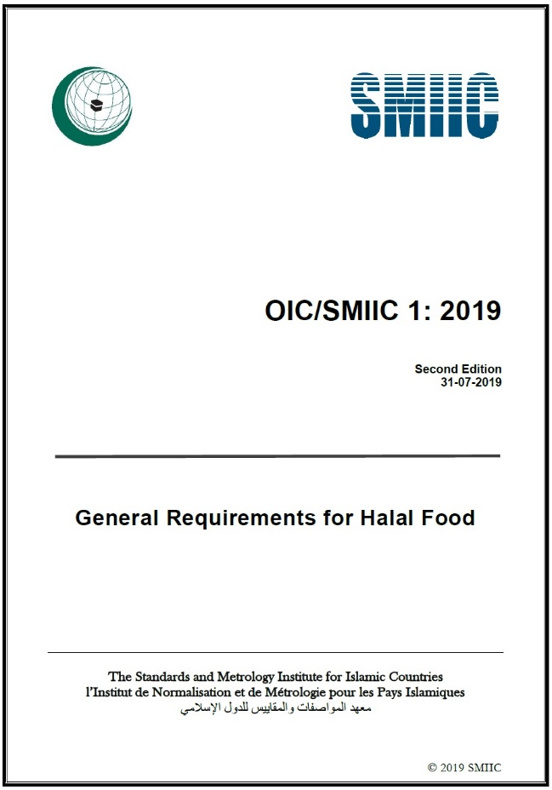
OIC/SMIIC 1
General Requirements for Halal Food:
Basic requirements of halal food and its products
based on Islamic rules for any stage of food chain such as:
preparation
processing
packaging, labelling and marking,
storage and service…etc.
34
Notes:
OIC/SMIIC 1 IS THE General Guidelines on Halal Food.
THE STANDARD DEFINES THE RULES FOR HALAL FOOD AND PRODUCTS PRODUCTION FOR ANY STAGE OF FOOD CHAIN: LIKE PRODUCTION SITE, PREPARATION, PROCESSING, PACKAGING, SERVING ….ETC.
THE NEW EDITION HAS BEEN PUBLISHED VERY RECENTLY.

Slide 36
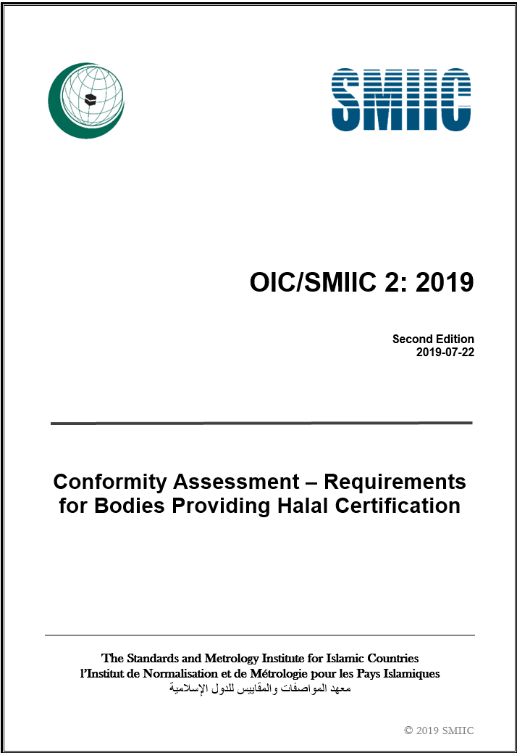
OIC/SMIIC 2
Conformity Assessment – Requirements for Bodies Providing Halal Certification :
requirements for halal certification bodies (HCBs).
to ensure that HCBs operate halal product or service or management system certification in a competent, consistent and impartial manner
35
Notes:
OIC/SMIIC 2 CAN BASICLY BE DEFINED AS THE RULES THAT SHOULD BE FOLLOWED BY HALAL CERTIFICATİON BODIES (HCBs) IN THEIR OPERATIONS REGARDING THE HALAL CERTIFICATION.
HOW HCBs SHOULD BE IN ORDER TO PROVIDE CERTIFICATION FOR A PRODUCT, SERVICE OR SYSTEM. HCB SHOULD BE COMPETENT, COSISTENT AND IMPARTIAL IN ITS OPERATIONS.
THIS STANDARD HAS BEEN REVISED IN SMIIC/CCA AND IN THE LAST MEETING AFTER VOTING PROCESS THE NEW EDITION HAS NOW BEEN PUBLISHED.

Slide 37
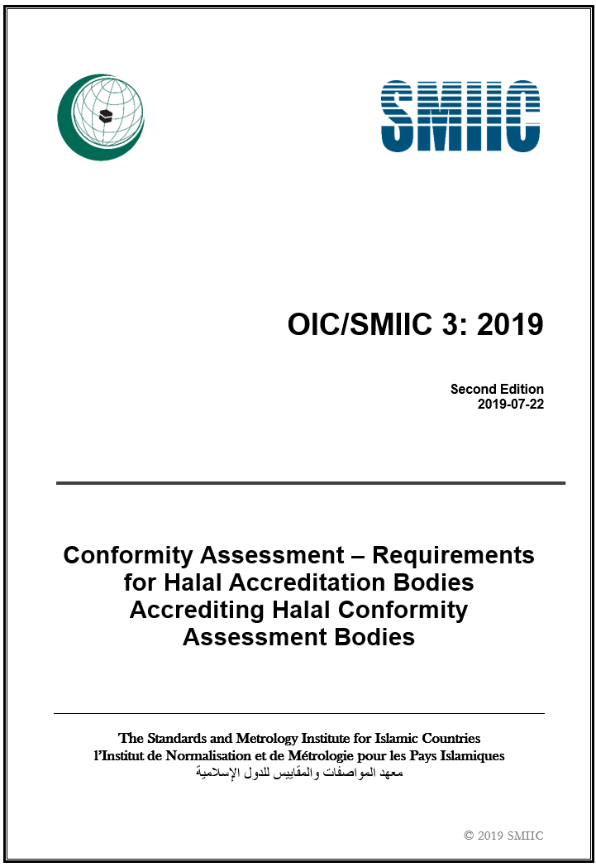
OIC/SMIIC 3
Conformity Assessment – Requirements for Halal Accreditation Bodies Accrediting Halal Conformity Assessment Bodies:
sets out the rules for the organizations providing accreditation services for halal certification bodies:
in OIC member countries or,
in those countries trading with OIC member countries or,
in any other country.
36
Notes:
OIC/SMIIC 3 IS THE REQUIREMENTS FOR ACCREDITATION BODIES ESTABLISHED AND PERFORMING HALAL ACCREDITATION IN OIC REGION.
AS PER THE STANDARD, ACCREDITATION CAN BE PERFORMED FOR HALAL CERTIFICATION BODIES IN OIC AND NON-OIC REGION.
THIS STANDARD HAS ALSO BEEN REVISED IN SMIIC/CCA IN THE LAST MEETING AND WE ARE HAPPY TO ANNOUNCE THAT NEW EDITION IS READY FOR YOUR USE.

Slide 38
OIC/SMIIC 4
OIC/SMIIC 4:2018, Halal Cosmetics - General Requirements
defines the basic requirements for the halal cosmetic industry
for every stage of cosmetic supply chain including, receiving, preparation, production, storage, packaging, labelling, controlling, handling, transportation, and distribution
applicable to all the categories of cosmetics and to all types of organizations irrespective of their size and complexity
37
Notes:
THIS STANDARD HAS BEEN PUBLISHED IN MARCH 2018, IT DEFINES THE BASIC REQUIREMENTS, BASED ON ISLAMIC RULES AND LAWS, THAT SHALL BE FULFILLED BY THE HALAL COSMETIC INDUSTRY DURING EVERY STAGE OF COSMETIC SUPPLY CHAIN INCLUDING, RECEIVING, PREPARATION, PRODUCTION, STORAGE, PACKAGING, LABELLING, CONTROLLING, HANDLING, TRANSPORTATION, AND DISTRIBUTION.
THIS STANDARD IS APPLICABLE TO ALL THE CATEGORIES OF COSMETICS AND TO ALL TYPES OF ORGANIZATIONS IRRESPECTIVE OF THEIR SIZE AND COMPLEXITY.

Slide 39
OIC/SMIIC 6
OIC/SMIIC 6:2019, OIC/SMIIC 6: 2019: Particular requirements for the application of OIC/SMIIC 1 to places where Halal foods and beverages are prepared, stored and served
covers particular requirements for halal servicing restaurants, hotels, cafeterias, self-service places, fast food sections of supermarkets and etc. catering services, raw materials used in such places, methods of preparation, storage and serving of meals, the personnel who are employed in these processes and the tools, utensils and facilities to be used.
aims to maintain efficiency in the application of OIC/SMIIC 1 to facilities (preparation, storage and serving).
38
Notes:
THIS STANDARD HAS BEEN PUBLISHED IN 2019, pursuant to OIC/SMIIC 1, IT COVERS THE BASIC REQUIREMENTS, COVERS PARTICULAR REQUIREMENTS FOR HALAL SERVICING RESTAURANTS, HOTELS (THEIR RESTAURANTS AND OPEN BUFFETS), CANTEENS, CAFETERIAS AND BUFFETS, SELF-SERVICE PLACES, FAST FOOD SECTIONS OF SUPERMARKETS, CATERING SERVICES DELIVERED DURING LAND, AIR, SEA TRAVELS, BAKERY OVENS AND PASTRIES, RAW MATERIALS USED IN SUCH PLACES, METHODS OF PREPARATION, STORAGE AND SERVING OF MEALS, THE PERSONNEL WHO ARE EMPLOYED IN THESE PROCESSES AND THE TOOLS, UTENSILS AND FACILITIES TO BE USED.
REQUIREMENTS IN THIS STANDARD HAVE BEEN ESTABLISHED TO INDICATE WHICH ADDITIONAL ACTIVITIES OR PRECAUTIONS HAVE TO BE CONDUCTED IN ORDER TO MAINTAIN EFFICIENCY IN THE APPLICATION OF OIC/SMIIC 1 TO FACILITIES WHERE HALAL FOOD AND BEVERAGES ARE PREPARED, STORED AND SERVED, AND TO ASSIST IN DETERMINING PARTICULAR REQUIREMENTS FOR THOSE FACILITIES.

Slide 40
OIC/SMIIC 9
defines the requirements for tourism industry players in setting up an assurance system to preserve the integrity of products and services provided for Muslim travelers.
is a guideline for managing halal tourism facilities, products and services for travellers in accommodation premises, tour packages, tourist guides and other tourist services.
is applicable to all organizations and individuals managing halal tourism products and services within the specified areas in the standard.
3 categories for accommodation
OIC/SMIIC 9:2019, Halal Tourism Services – General Requirements
39
Notes:
THIS STANDARD HAS BEEN FINALIZED AND APPROVED IN 2019, IT DEFINES THE REQUIREMENTS, BASED ON ISLAMIC RULES AND LAWS, WHICH SHALL BE MET BY THE HALAL TOURISM INDUSTRY INCLUDING ACCOMMODATION PREMISES, PRODUCTS AND SERVICES, TOUR PACKAGES AND ALL OTHER RELEVANT TOURIST SERVICES.
THIS STANDARD IS APPLICABLE TO ALL ORGANIZATIONS AND INDIVIDUALS MANAGING HALAL TOURISM PRODUCTS AND SERVICES WITHIN THE SPECIFIED AREAS.

Slide 41
OIC/SMIIC 24
OIC/SMIIC 24:2020, General Requirements for Food Additives and Other Added Chemicals to Halal Food
specifies the requirements and conditions needed for food additives and any other added chemicals (processing aids, flavourings, added nutrients, enzymes) used during food production to ensure that the final product is halal and safe to consume in OIC countries and all over the world.
also defines the halal status of food additives in foodstuffs intended for human consumption.
40
Notes:
THIS STANDARD HAS BEEN FINALIZED AND PUBLISHED VERY RECENTLY, IT DEFINES THE REQUIREMENTS FOR FOOD ADDITIVES AND ANY OTHER CHEMICALS USED DURING PRODUCTION IN ORDER TO ENSURE THE FINAL PRODUCT IS HALAL AND SAFE FOR CONSUMPTION.
ALSO, WITH ITS LIST OF DOUBTFUL AND NON-HALAL FOOD ADDITIVES AND THE NEEDED ACTION FOR EACH OF THEM, IT SPECIFIES THE HALAL STATUS OF FOOD ADDITIVES IN FOODSTUFF.

Slide 42
OIC/SMIIC 33
OIC/SMIIC 33:2020; Conformity Assessment – Example of a Certification Scheme for Halal Products
f
describes the fundamentals of halal product certification and provides guidelines for understanding, developing, operating or maintaining certification schemes for halal products, processes and services.
provides an example of a type 5 product certification scheme for halal products as described in ISO/IEC 17067 based on Islamic rules.
41
Notes:
THIS STANDARD HAS BEEN FINALIZED AND APPROVED VERY RECENTLY, IT DESCRIBES THE FUNDAMENTALS OF HALAL PRODUCT CERTIFICATION.
IT GIVES AN EXAMPLE OF A HALAL PRODUCT CERTIFICATION SCHEME REFLECTS A TYPE 5 PRODUCT CERTIFICATION SCHEME AS EXPLAINED IN ISO/IEC 17067.

Slide 43
OIC/SMIIC 34
OIC/SMIIC 34:2020; Conformity Assessment - General Requirements for Bodies Operating Certification of Persons Involved in the Halal Related Activities
contains principles and general requirements for bodies operating certification of persons involved in the halal related activities against specific requirements, and includes the development and maintenance of a certification scheme for these persons.
can be used by governmental authorities, programme owners and others as a document of criteria for accreditation, peer assessment and appointment.
f
42
Notes:
THIS CONFORMITY ASSESSMENT STANDARD HAS BEEN FINALIZED AND APPROVED VERY RECENTLY, IT CONTAINS PRINCIPLES AND GENERAL REQUIREMENTS FOR BODIES OPERATING CERTIFICATION OF PERSONS INVOLVED IN THE HALAL RELATED ACTIVITIES.
IT CAN BE USED BY GOVERNMENTAL AUTHORITIES, PROGRAMME OWNERS AND OTHERS AS A DOCUMENT OF CRITERIA FOR ACCREDITATION, PEER ASSESSMENT AND APPOINTMENT.

Slide 44
OIC/SMIIC 35
OIC/SMIIC 35:2020; Conformity Assessment - General Requirements for the Competence of Laboratories Performing Halal Testing
f
specifies the general requirements for Laboratories performing Halal Testing.
Compliance to this document does not in any way exempt laboratories from or diminish their responsibilities in observing/complying with existing national laws and regulations/guidelines currently enforced in the country
43
Notes:
THIS IS THE OTHER CONFORMITY ASSESSMENT STANDARD OF SMIIC/CCA WHICH HAS BEEN FINALIZED AND APPROVED VERY RECENTLY, IT SPECIFIES THE GENERAL REQUIREMENTS FOR LABORATORIES PERFORMING HALAL TESTING. ALL THE ORGANIZATIONS PERFORMING LABORATORY ACTIVITIES ARE INCLUDED TO THE SCOPE OF THIS DOCUMENT.
LABORATORIES, BY IMPLEMENTING THIS STANDARD, WILL NOT DIMINISH THEIR COMPLIANCE WITH EXISTING NATIONAL LAWS.

Slide 45
OIC/SMIIC 36
OIC/SMIIC 36:2020; Conformity Assessment - General Requirements of Proficiency Testing for Halal Purposes
f
specifies general requirements for the competence of providers of halal proficiency testing schemes and for the development and operation of halal proficiency testing schemes.
can be used as a basis for specific technical requirements for particular fields of application.
44
Notes:
ANOTHER CONFORMITY ASSESSMENT STANDARD FOR PROFICIENCY TESTING FOR HALAL PURPOSES HAS BEEN APPROVED AND PUBLISHED ALONG WITH OTHER STANDARDS OF SMIIC/CCA. IT SPECIFIES THE GENERAL REQUIREMENTS FOR THE COMPETENCE OF PROVIDERS OF HALAL PROFICIENCY TESTING SCHEMES AND FOR THE DEVELOPMENT AND OPERATION OF HALAL PROFICIENCY TESTING SCHEMES.

Slide 46
WHAT IS QUALITY INFRASTRUCTURE?
Quality infrastructure refers “to all aspects of standardization, metrology, accreditation and conformity assessment (testing, management systems, inspection, certification) that have a bearing on conformity assessment.
Quality infrastructure is a system of institutions which jointly ensure that products and processes meet predefined specifications which are standards.
45
Notes:
SO, LET’S HAVE A LOOK AT THE CONCEPT OF QUALITY INFRASTRUCTURE AND THEN EXPLAIN BRIEFLY HALAL QUALITY INFRASTRUCTURE.
QUALITY INFRASTRUCTURE IS GENERALLY UNDERSTOOD TO BE THE TOTALITY OF THE INSTITUTIONAL FRAMEWORK (PUBLIC AND PRIVATE) REQUIRED TO ESTABLISH AND IMPLEMENT STANDARDIZATION, METROLOGY, ACCREDITATION AND CONFORMITY ASSESSMENT SERVICES (INSPECTION, TESTING, PRODUCT AND SYSTEM CERTIFICATION) NECESSARY TO PROVIDE ACCEPTABLE EVIDENCE THAT PRODUCTS AND SERVICES MEET DEFINED REQUIREMENTS, BE IT DEMANDED BY AUTHORITIES OR THE MARKET PLACE.
IN BRIEF, IT IS THE COMPOSITION OF FOUR ESSENTIAL PILLARS NAMELY, STANDARDIZATION, METROLOGY, ACCREDITATION AND CONFORMITY ASSESSMENT TO SAFEGUARD THE TRANSPARENCY OF PROCESSES BY REQUIRED STANDARDS.

Slide 47
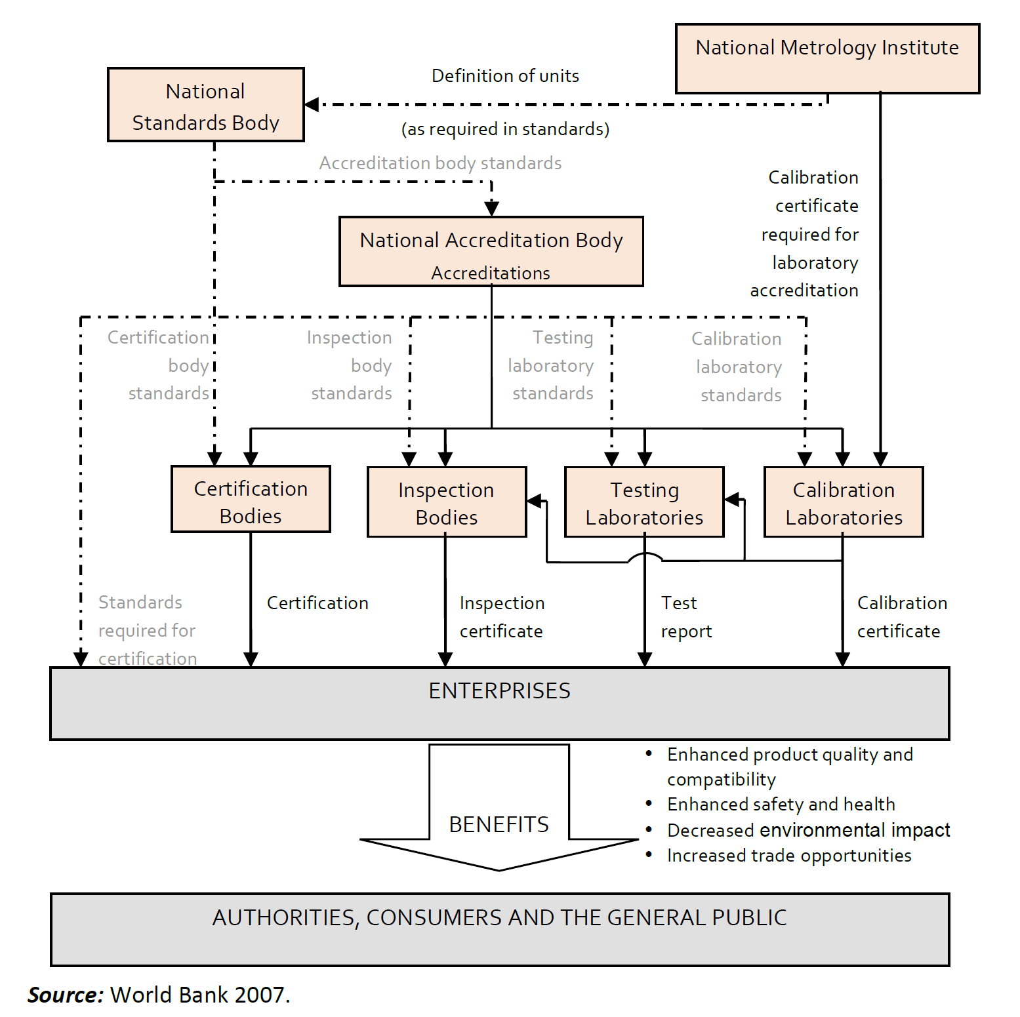
OVERALL QUALITY INFRASTRUCTURE
46
Notes:
QUALITY INFRASTRUCTURE RELIES ON THE SCIENTIFIC AND TECHNICAL FOUNDATIONS OF
STANDARDISATION BODIES AND METROLOGY INSTITUTIONS (SCIENTIFIC, INDUSTRIAL AND LEGAL), AND
TO UNDERPIN:
ACCREDITATION, CONFORMITY ASSESSMENT (SUPPLIER’S DECLARATION, CERTIFICATION, TESTING, VERIFICATION, AND INSPECTION), CALIBRATION, AND MARKET SURVEILLANCE.
STANDARDIZATION IS AT THE CENTER AND STANDARDS FOR EVERY ELEMENT OF THE QUALITY INFRASTRUCTURE ARE ESSENTIAL. LIKE STANDARDS FOR PRODUCTS MANUFACTURED BY ENTERPRISES, TESTING LABORATORY STANDARDS, CERTIFICATION BODY STANDARDS OR ACCREDITATION BODY STANDARDS, ETC.
AND AT THE END THE CONSUMERS, MANUFACTURERS AND GOVERNMENTS BENEFIT FROM THE RESULTS OF A WELL-ESTABLISHED QUALITY INFRASTRUCTURE.

Slide 48
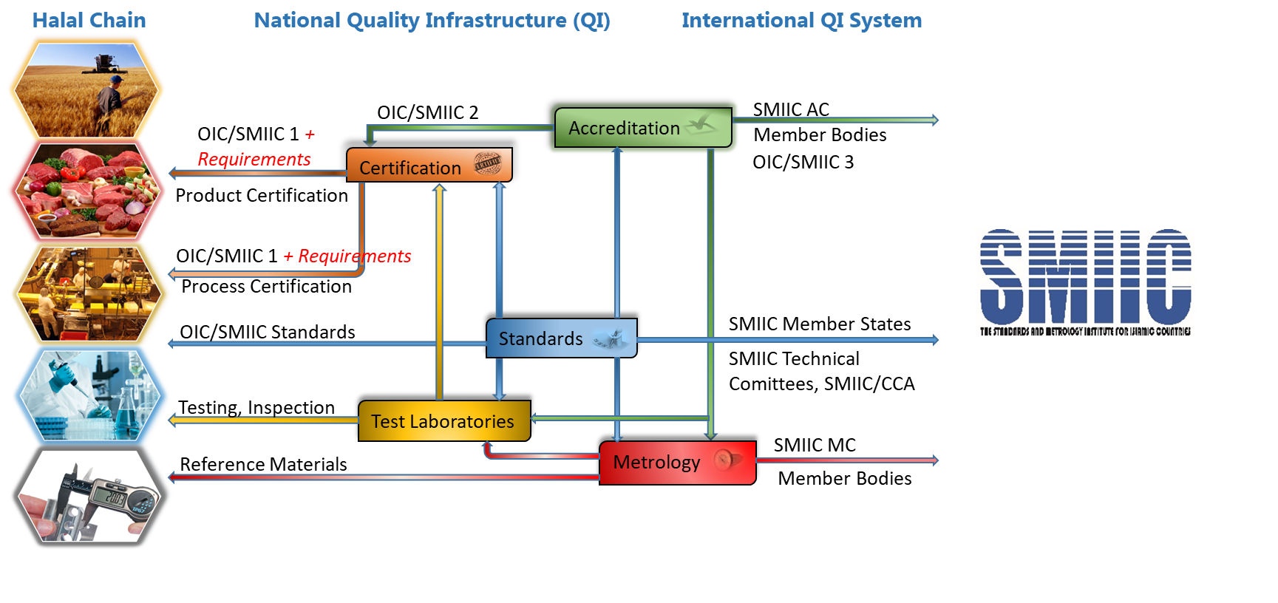
OIC GLOBAL HALAL QUALITY INFRASTRUCTURE
47
Notes:
AFTER THIS BRIEF INFORMATION ABOUT THE “QUALITY INFRASTRUCTURE”, LETS SEE WHERE IS SMIIC IN THIS PICTURE AND WHAT IS THE ROLE OF SMIIC FOR HALAL INDUSTRY.
BUILDING HALAL QUALITY INFRASTRUCTURE IN ORDER TO HAVE RELIABLE HALAL PRODUCTS AND SERVICES IN OIC COUNTRIES AND FOR ALL MUSLIMS ALL OVER THE WORLD IS ONE OF THE MAIN OBJECTIVES OF SMIIC.
AS YOU SEE, MAIN TARGET IS TO PROVIDE A TRUSTWORTHY HALAL FOOD CHAIN FROM FARM TO FORK,
ALL ELEMENTS OF QUALITY INFRASTRUCTURE, STANDARDIZATION, METROLOGY, CONFORMITY ASSESMENT, AND ACCREDITATON HAVE AN EFFECT ON HALAL FOOD CHAIN AT NATIONAL LEVEL AS WELL AS AT INTERNATIONAL LEVEL. ALL QUALITY INFRASTRUCTURE ELEMENTS NEED A STANDARD TO PERFORM SAME APPLICATIONS FOR THE SAME CASES. WITHOUT COMMON STANDARDS YOU COULD NOT ESTABLISH ANY INFRASTRUCTURE BECAUSE WHAT YOU WOULD HAVE ONLY DIFFERENT MECHANISMS WHICH DO NOT HAVE ANY RECOGNITION.
AND SMIIC AS THE STANDARDIZATION BODY IS AT THE CENTER OF THIS BY ISSUING STANDARDS FOR PRODUCTS, CERTIFICATION, CONFORMITY ASSESSMENT, ACCREDITATION, …ETC IN ORDER TO BUILD THIS HALAL QUALITY INFRASTRUCTURE AS A WHOLE SYSTEM.

Slide 49
OIC GLOBAL HALAL QUALITY INFRASTRUCTURE
Travel of a Product (Farm to Fork)
Customer Needs / Requirements
Raw material
Manufacturing
Standards,
Technical Regulations,
Directives, and
Laws
Standards
Certification
Accredited
CABs
Laboratory
Testing
Complaint
handling
LOGO
Standards
Audit Management
Product
Inspection
Warranty
Customer Satisfaction
Inspection
Standards
Storage
Labelling
Distribution
Retail
Standards
End user
Standards
48
Notes:
ON THIS SLIDE, YOU CAN SEE A PRODUCT’S TRAVEL FROM FARM OR FACTORY TO YOUR FORK OR DINNER TABLE.
IN EACH LEVEL WE NEED STARDARDIZED RULES TO ENSURE THE PROCESS TO BE MORE EFFECTIVE AND TRUSTWORTHY.
ALSO, WE DO NEED A WELL-ESTABLISHED INFRASTRUCTURE TO MONITOR THE TRANSPARENCY OF THE WHOLE OPERATION.
THIS IS THE INTERNATIONAL APPLICATION OF TRAVEL OF A PRODUCT AND OIC/SMIIC STANDARDS CAN BE USED WHEREVER STANDARDIZED RULES ARE REQUIRED.

Slide 50
SYSTEM BASED ON OIC/SMIIC STANDARDS
Accreditation of certifiers according to OIC/SMIIC 2 by the accreditation body in compliance with OIC/SMIIC 3.
3
Certification of producers according to OIC/SMIIC 1 by the certifiers in compliance with OIC/SMIIC 2.
2
Production/service in compliance with OIC/SMIIC 1, 4, 6, 9 and etc.
1
49
Notes:
NOW I WANT TO SUMMARIZE QUALITY INFRASTRUCTURE BASED ON OIC/SMIIC STANDARDS.
OIC/SMIIC 1, GENERAL REQUIREMENTS FOR HALAL FOOD, TO BE USED BY THE PRODUCERS AND CERTIFIERS
OIC/SMIIC 2, CONFORMITY ASSESSMENT – REQUIREMENTS FOR BODIES PROVIDING HALAL CERTIFICATION, TO BE USED BY CERTIFIERS AND ACCREDITATON BODIES
OIC/SMIIC 3, CONFORMITY ASSESSMENT - REQUIREMENTS FOR HALAL ACCREDITATION BODIES ACCREDITING HALAL CONFORMITY ASSESSMENT BODIES, TO BE USED BY ACCREDITATION BODIES.
SO BASICLY,
PRODUCTION IN COMPLIANCE WITH OIC/SMIIC 1;
CERTIFICATION AGAINST OIC/SMIIC 2 BY THE CERTIFIERS
ACCREDITATION AGAINST OIC/SMIIC 3.

Slide 51
BENEFITS OF HALAL QUALITY INFRASTRUCTURE
Increase of consumer trust on Halal
Mutual Recognition
Tracebility
Diminishing technical barriers to trade
The Result
50
Notes:
ALL IN ALL, WITH THIS HALAL QUALITY INFRASTRUCTURE,
CONSUMER TRUST ON HALAL PRODUCTS WILL INCREASE SINCE WE WILL HAVE THE OPPORTUNITY TO TRACE THE PROCESS .
AND MUTUAL RECOGNITION OF CERTIFICATES THROUGH ACCREDITATION BY RELEVANT PARTIES WILL DIMINISH TECHNICAL BARRIERS TO TRADE.
FINALLY ALL THESE APLLICATIONS WILL FACILATE HALAL TRADE.

Slide 52
CONCLUSION
OIC/SMIIC standards are the result of a common study of OIC Members and its partners through the technical committees.
SMIIC is a common platform to set for all stakeholders.
OIC/SMIIC Halal Standards are common standards for the Muslim World and all interested parties.
51
Notes:
FINAL WORDS,
SMIIC IS THE COMMON PLATFORM TO GATHER THE ALL STAKEHOLDERS TO CONTRIBUTE TO THE COMMON STANDARDS FOR THE MUSLIM WORLD AND ALL INTERESTED PARTIES.
SMIIC IS A UNITY IN DIVERSITY GATHERING 42 COUNTRIES UNDER A ROOF. AND WE ALWAYS NEED MORE OF EXPERTISE, COMPETENCE AND DEDICATION.
SO, I SUGGEST LET’S WORK TOGETHER AND PREPARE OUR STANDARDS.
WE WOULD BE GLAD TO GET YOUR SUPPORT AND CONTRIBUTION.
HENCE, BE OUR PARTNER FOR STANDARDS AND RELATED ISSUES.

Slide 53
THANKS
SMIIC General Secretariat İstanbul Dünya Ticaret Merkezi A1 Blok No: 437-438 K:14 Yeşilköy, Bakırköy-İstanbul/TURKEY, 34149 Tel.: +90 212 465 65 07 or +90 212 465 65 08 Fax: +90 212 465 65 09 E-mail: secretariat@smiic.org; Web: www.smiic.org
52
Notes:
THANK YOU VERY MUCH FOR YOUR KIND ATTENTION AND PATIENCE.
WASSALAMU ALAYKUM VE RAHMATULLAHI VE BARAKATUHU.

